Slide 1
APP310 Resource Scheduling Using Apache Mesos in the Cloud
Sharma Podila, Netflix
November 14, 2014 | Las Vegas, NV

Slide 2
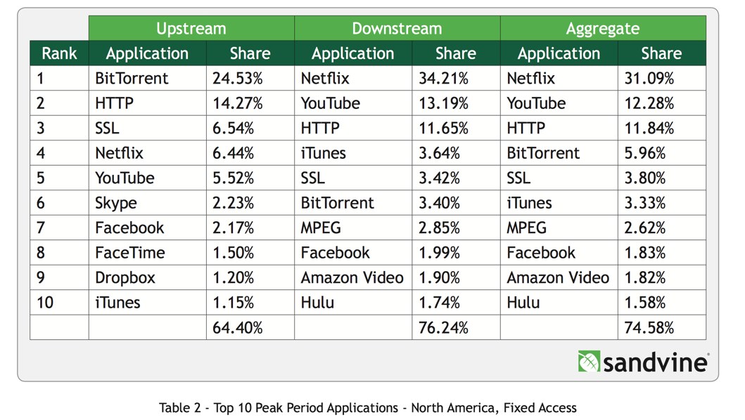
Scale to Internet traffic
At peak, >1/3 of downstream, >6.4% of upstream Internet traffic

Slide 3

Scale to Internet traffic

Slide 4
Scale to Internet traffic
Detect signals (e.g., anomalies)
Track big signals + all permutations
Do it quickly to resolve ASAP
Do it cheap
Scale with Netflix traffic

Slide 5
Context
Operational Insights initiative, part of Netflix Edge Engineering

Slide 6
Context
Operational Insights initiative, part of Netflix Edge Engineering
Tools to detect and visualize service health, anomalies, and customers’ streaming experience

Slide 7
Context
Operational Insights initiative, part of Netflix Edge Engineering
Tools to detect and visualize service health, anomalies, and customers’ streaming experience
Event stream processing to run ad hoc queries on live event streams

Slide 8
Context
Operational Insights initiative, part of Netflix Edge Engineering
Tools to detect and visualize service health, anomalies, and customers’ streaming experience
Event stream processing to run ad hoc queries on live event streams
Resource scheduling optimizations for cloud native, reactive stream processing

Slide 9
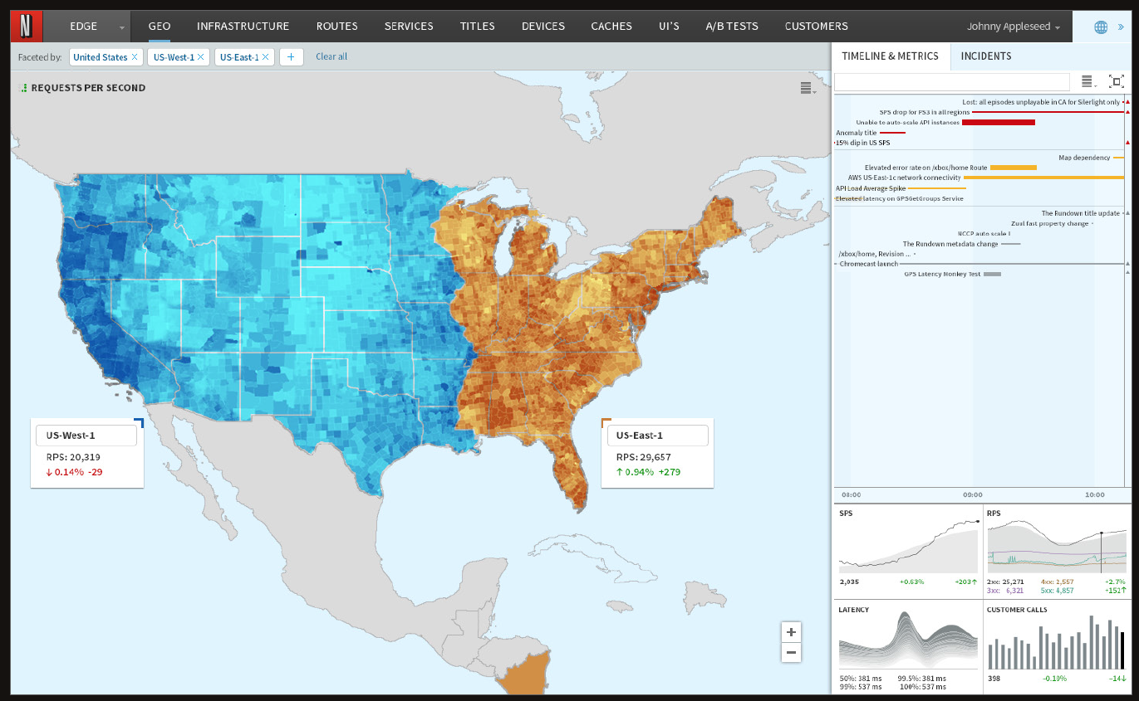
Dynamic data visualization
Mock up

Slide 10
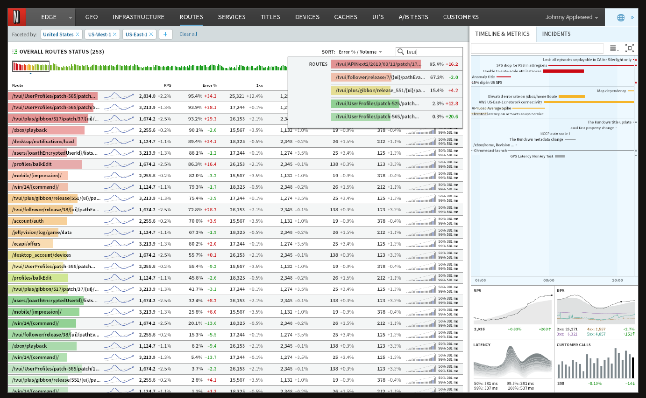
Summary and faceted queries
Mock up

Slide 11
Agenda
Mantis: an operational insights infrastructure
Why use Apache Mesos in Amazon EC2?
Do we need yet another Apache Mesos framework?
Challenges from stream processing in a cloud
Framework design choices
Fenzo: customizable scheduler for any framework
Sample scheduler usage

Slide 12
Mantis: infrastructure for operational insights
Anomaly detection
System health
Insights
Customer experience
Analytics

Slide 13

Mantis: reactive stream processing
Cloud native
Autoscaled cluster

Slide 14
Mantis: reactive stream processing
Cloud native
Autoscaled cluster
Stream locality

Slide 15
Mantis: reactive stream processing
Cloud native
Autoscaled cluster
Stream locality
Job “light weight” or dynamic
Configurable job SLA
Autoscale for optimal utilization

Slide 16
Bidirectional data sourcing
0
User
Job 1
1
0
Subscription
2
Subscribe with query
1
User
Job 2
2
Discovery
Data pushed with
subscription ID
Source app instances
3
4
User
Job 3
5
999
Source connector
job

Slide 17
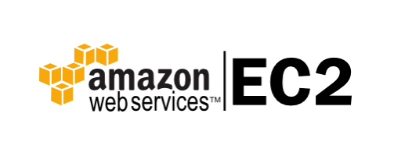
Mantis system overview
ZooKeeper
Apache Mesos
Apache Mesos
Apache Mesos
Apache Mesos
Slave Cluster
Mantis
ASG
Mantis
ASG
Mantis
ASG
Mesos
Framework
Instance
Fenzo

Slide 18
Mantis scheduling model
Jobs may be perpetual or
on-demand/interactive
Slave instances
Job
Job
Job
Source
Stage1
Stage2
Sink

Slide 19
Apache Mesos
Cluster resource manager

Slide 20
Apache Mesos
Cluster resource manager
“Develop and run resource-efficient distributed systems”

Slide 21
Apache Mesos
Cluster resource manager
“Develop and run resource-efficient distributed systems”
“Simplifies the complexity of running applications on a shared pool of servers”

Slide 22
Apache Mesos architecture
ZooKeeper
quorum
FrmWrk1
FrmWrk2
Mesos master
Standby master
Standby master
Mesos slave
Mesos slave
Mesos slave
FrmWrk1 executor
FrmWrk1 executor
FrmWrk2 executor
FrmWrk2 executor
Task
Task
Task
Task
Task
Task

Slide 23
Why Apache Mesos in a cloud?
Resource granularity
Task startup latency

Slide 24
Resource granularity
Instance 1
Instance 1
Instance 1
Instance 2
Instance 1
Task C
Task D
vs.
Task B
Task A
Task B
Task A
Task A

Slide 25


Task startup latency
vs.
Instance startup in mins.
Mesos task startup in <1sec

Slide 26
Why another framework?
Writing an Apache Mesos framework can be easy
But not so easy to have fault-tolerance, scalability, performance, and high availability
Scheduling can be a hard problem to solve
You must have a good long-term reason to write your own framework

Slide 27
Challenges in a cloud
Fault tolerance with ephemeral slave instances

Slide 28
Challenges in a cloud
Fault tolerance with ephemeral slave instances
High availability for Apache Mesos master and framework

Slide 29
Challenges in a cloud
Fault tolerance with ephemeral slave instances
High availability for Apache Mesos master and framework
Autoscaling slave cluster

Slide 30
Challenges in a cloud
Fault tolerance with ephemeral slave instances
High availability for Apache Mesos master and framework
Autoscaling slave cluster
Scheduling challenges
Autoscaling
Resource utilization optimization

Slide 31
The autoscaling challenge
Scaling up in Amazon EC2 is relatively easy
= f(#Pending Tasks)
Scaling down requires bin packing

Slide 32
The autoscaling challenge
Scaling up in Amazon EC2 is relatively easy
= f(#Pending Tasks)
Scaling down requires bin packing
Host 1
Host 2
Host 3
Host 4

Slide 33
The autoscaling challenge
Scaling up in Amazon EC2 is relatively easy
= f(#Pending Tasks)
Scaling down requires bin packing
Host 1
Host 2
Host 3
Host 4
vs.
Host 1
Host 2
Host 3
Host 4

Slide 34
The autoscaling challenge
Scaling up in Amazon EC2 is relatively easy
= f(#Pending Tasks)
Scaling down requires bin packing
Host 1
Host 2
Host 3
Host 4
vs.
Host 1
Host 2
Host 3
Host 4

Slide 35
Stream locality challenge
Data stream
Host A
Host B
Host C
Task1
Task2
Task3

Slide 36
Stream locality challenge
Data stream
Data stream
vs.
Host X
Host A
Host B
Host C
Task1
Task1
Task2
Task3
Task2
Task3
Reduces network bandwidth usage

Slide 37
Stream processing challenges
Back pressure, consistent indexing, dynamic horizontal scaling, etc.
Source
Sink
Stage 1
Stage 3
Stage 2
Processor task

Slide 38
Stream processing challenges
Back pressure, consistent indexing, dynamic horizontal scaling, etc.
On back pressure, scale
horizontally
Source
Sink
Stage 1
Stage 3
Stage 2
Processor task

Slide 39
Framework design

Slide 40
Framework design choices
Framework availability
Coarse-grain vs. fine-grain allocation
Task state persistence and reconciliation
Check pointing
Offers hoarding

Slide 41
Framework availability
ZooKeeper Cluster
Mantis
Mantis
Mantis
Mesos
Framework
Fenzo

Slide 42
Resource allocation granularity
Mesos slave
Mesos slave
Framework executor
Framework executor
FrmWrk1 executor
FrmWrk1 executor
Task
Task
Task
Task
Coarse grain
Fine grain

Slide 43
Task state persistence
Apache Mesos
Task status update
Apache Mesos
Mesos Master
Apache Mesos
Framework
Task metadata store
Persistence

Slide 44
Task state persistence
Apache Mesos
Task status update
Apache Mesos
Mesos Master
Apache Mesos
Framework
Task metadata store
Task state reconciliation
Persistence

Slide 45
Mesos checkpoint feature
Master:
FrameworkInfo framework = FrameworkInfo.newBuilder()
.setName(name)
.setFailoverTimeout(to)
.setId(id)
.setCheckpoint(true)
.build();
Slave:
% mesos-slave \
--checkpoint \
--recover=reconnect \
--strict=false
<other options>

Slide 46
Relinquishing Mesos offers
Currently, Mesos’ resource offers are exclusive to your framework
In a shared cluster environment, hoarding unused offers is an abuse of resources

Slide 47
Task scheduling

Slide 48
Task scheduling objectives
Quickly assign resources to tasks
Heterogeneous mix of resources and tasks
Scheduling resources to tasks is computationally expensive

Slide 49
Task scheduling objectives
Quickly assign resources to tasks
Heterogeneous mix of resources and tasks
Scheduling resources to tasks is computationally expensive
Customizable service level objectives, constraints
Autoscaling
Task locality/affinity
Availability Zone balancing
Plugins for extensibility

Slide 50
Task scheduler, Fenzo
Generic task scheduler
Heterogeneous
Plugins for
Constraints, Fitness
Autoscale
Visibility
High speed

Slide 51
Task scheduler, Fenzo
The scheduling problem and optimizations
Algorithm
Plugins: fitness calculators and constraints
Bin packing experiment
Autoscaling
Sample Java code usage

Slide 52
Fenzo usage in frameworks
Mesos master
Mesos framework
Persistence
Tasks
requests
Task assignment result
Host1
Task1
Task2
Host2
Task3
Task4
Fenzo task
scheduler
Available
resource
offers

Slide 53
The scheduling problem
N tasks to assign from M possible slaves
Urgency
Assigned
Pending
Fitness

Slide 54
Scheduling optimizations
Speed
Accuracy
First fit assignment
Optimal assignment
Real world trade-offs
~ O (1)
~ O (N * M)¹
¹ Assuming tasks are not reassigned

Slide 55
Fenzo scheduling algorithm
For each task:
Evaluate constraint, fitness (plugin) on each host
Until fitness is “good enough”
and
A minimum number of hosts have some fitness
(Fitness/constraint evaluation across hosts happens concurrently on all cores)

Slide 56
Scheduling constraints
Each task can specify zero or more constraints

Slide 57
Scheduling constraints
Each task can specify zero or more constraints
Hard constraints
Must satisfy

Slide 58
Scheduling constraints
Each task can specify zero or more constraints
Hard constraints
Must satisfy
Soft constraints
Satisfy if possible

Slide 59
Hard constraints
Affects resource selection
Evaluated first to filter out hosts that can’t satisfy them
Examples:
Only use instances of certain type for some tasks
Only one task per Availability Zone

Slide 60
Soft constraints
Affects task placement
Evaluated along with fitness calculator for best host
Examples:
Balance tasks across Availability Zones as much as possible
Prefer certain EC2 instance types if available

Slide 61
Fenzo fitness/constraint plugins
Bin packing
CPU, memory, and CPU+memory bin packing

Slide 62
Fenzo fitness/constraint plugins
Bin packing
CPU, memory, and CPU+memory bin packing
Host attribute value constraint
E.g., assign slaves of specific Availability Zones or instance types

Slide 63
Fenzo fitness/constraint plugins
Bin packing
CPU, memory, and CPU+memory bin packing
Host attribute value constraint
E.g., assign slaves of specific Availability Zones or instance types
Unique host attribute constraint
Assign hosts with unique attribute names for co-tasks
E.g., host name, Availability Zones

Slide 64
Fenzo fitness/constraint plugins
Exclusive host constraint
Use a host exclusively for a task

Slide 65
Fenzo fitness/constraint plugins
Exclusive host constraint
Use a host exclusively for a task
Balance host attribute constraint
Balance hosts across co-tasks such that equal numbers are used for different attribute values
E.g., balance across Availability Zones

Slide 66
Fenzo fitness/constraint plugins
Exclusive host constraint
Use a host exclusively for a task
Balance host attribute constraint
Balance hosts across co-tasks such that equal numbers are used for different attribute values
E.g., balance across Availability Zones
Each of these can be specified as hard or soft constraints

Slide 67
Bin packing fitness calculator
fitness = usedCPUs / totalCPUs
Fitness for
Host1
Host2
Host3
Host4
Host5

Slide 68
Bin packing fitness calculator
fitness = usedCPUs / totalCPUs
Fitness for
0.25
0.5
0.75
1.0
0.0
Host1
Host2
Host3
Host4
Host5

Slide 69
Bin packing fitness calculator
fitness = usedCPUs / totalCPUs
✔
Fitness for
0.25
0.5
0.75
1.0
0.0
Host1
Host2
Host3
Host4
Host5

Slide 70
A bin packing experiment
Assign resources to tasks from ~3,000 8-CPU slaves
Tasks of different sizes: 1-CPU, 3-CPU, 6-CPU
Iteratively assign bunch of tasks starting from a clean slate
Run about 50 iterations with and without bin packing fitness plugin

Slide 71
Bin packing sample results
Bin pack tasks using existing CPU bin packer

Slide 72
Task runtime bin packing
Bin pack tasks based on short vs. long expected run times

Slide 73
Stream locality fitness
Stream locality fitness
= percentage of tasks connecting to the same stream

Slide 74
Composable fitness calculators
Fitness
= ( BinPackFitness * BinPackWeight +
RuntimePackFitness * RuntimeWeight +
StreamLocalityFitness * StreamWeight
) / 3.0

Slide 75
Autoscaling cluster in Fenzo
Scale up and down Apache Mesos slave cluster based on actual demand
Rules based
Resource shortfall analysis based

Slide 76
Rules-based autoscaling
Set up rules per host attribute value
E.g., one autoscale rule per ASG/cluster, one cluster for network-intensive jobs, another for CPU/memory-intensive jobs
Sample:
ClusterName, MinIdle, MaxIdle, CoolDownSecs
NwkClstr,10,20,360; CmputeClstr,5,20,300
Trigger down scale
#Idle
hosts
max
min
Trigger up scale

Slide 77
Scaling up via shortfall analysis
Rule-based scale up has a cool down period
What if there’s a surge of incoming requests?
Pending requests triggers shortfall analysis
Scale up happens regardless of cool down period
Remembers which tasks have already been covered

Slide 78
Autoscaling actions from Fenzo
ScaleUp action:
Cluster, N
ASG/Cluster: mantisagent
MinIdle: 8
MaxIdle: 20
CooldownSecs: 360
ASG/Cluster: mantisagent
MinIdle: 8
MaxIdle: 20
CooldownSecs: 360
ASG/cluster: mantisagent
MinIdle: 8
MaxIdle: 20
CooldownSecs: 360
Fenzo
ScaleDown action:
Cluster, HostList

Slide 79
Auto Scaling strategy
EC2 Auto Scaling groups have 3 numbers to control
Use “desirable” value to set via Fenzo
Let max instances value limit your scale up
Let min instances value define minimum size
External coarse-grain scaling strategy can set the minimum
E.g., Netflix’s Scryer¹ predicts capacity based on historic usage
¹ http://techblog.netflix.com/2013/11/scryer-netflixs-predictive-auto-scaling.html

Slide 80
Sample Fenzo usage: builder
scheduler = new TaskScheduler.Builder()
// auto release unused resource offers
.withLeaseOfferExpirySecs(60)
// action to take for releasing offers
.withLeaseRejectAction( (lease) -> {
mesosDriver.declineOffer(lease.getOffer().getId());
} )
.build();

Slide 81
Sample Fenzo usage: builder
scheduler = new TaskScheduler.Builder()
.withLeaseOfferExpirySecs(60)
.withLeaseRejectAction( (lease) -> {
mesosDriver.declineOffer(lease.getOffer().getId());
})
// use built-in bin packer
.withFitnessCalculator(
BinPackingFitnessCalculators.cpuBinPacker)
.build();

Slide 82
Sample Fenzo usage: builder
scheduler = new TaskScheduler.Builder()
.withLeaseOfferExpirySecs(60)
.withLeaseRejectAction( (lease) -> {
mesosDriver.declineOffer(lease.getOffer().getId());
} )
.withFitnessCalculator(
BinPackingFitnessCalculators.cpuBinPacker)
// trade off assignment quality with speed
.withFitnessGoodEnoughFunction( (f) ->
{ return f>0.5; } )
.build();

Slide 83
To summarize…

Slide 84
Why Apache Mesos in a cloud?
Resource granularity
Task startup latency

Slide 85
Task scheduler, Fenzo
Generic task scheduler
Heterogeneous
Plugins for
Constraints, Fitness
Autoscale
Visibility
High speed

Slide 86
Mantis system overview
ZooKeeper
Apache Mesos
Apache Mesos
Apache Mesos
Apache Mesos
Slave Cluster
Mantis
ASG
Mantis
ASG
Mantis
ASG
Mesos
Framework
Instance
Fenzo

Slide 87
Dynamic data visualization
Mock up

Slide 88
Netflix talks at re:Invent
Talk | Time | Title
PFC-305 | Wednesday, 1:15pm | Embracing Failure: Fault Injection and Service Reliability
BDT-403 | Wednesday, 2:15pm | Next Generation Big Data Platform at Netflix
PFC-306 | Wednesday, 3:30pm | Performance Tuning EC2
DEV-309 | Wednesday, 3:30pm | From Asgard to Zuul, How Netflix’s proven Open Source Tools can accelerate and scale your services
ARC-317 | Wednesday, 4:30pm | Maintaining a Resilient Front-Door at Massive Scale
PFC-304 | Wednesday, 4:30pm | Effective Inter-process Communications in the Cloud: The Pros and Cons of Micro Services Architectures
ENT-209 | Wednesday, 4:30pm | Cloud Migration, Dev-Ops and Distributed Systems
APP-310 | Friday, 9:00am | Scheduling using Apache Mesos in the Cloud

Slide 89
APP310

